Slide 1
I045 – Moderni računalni sustavi
Predavanje 6
Luka Borozan

Slide 2
Zadatak
Implementirajte procesor (CPU)

Slide 3
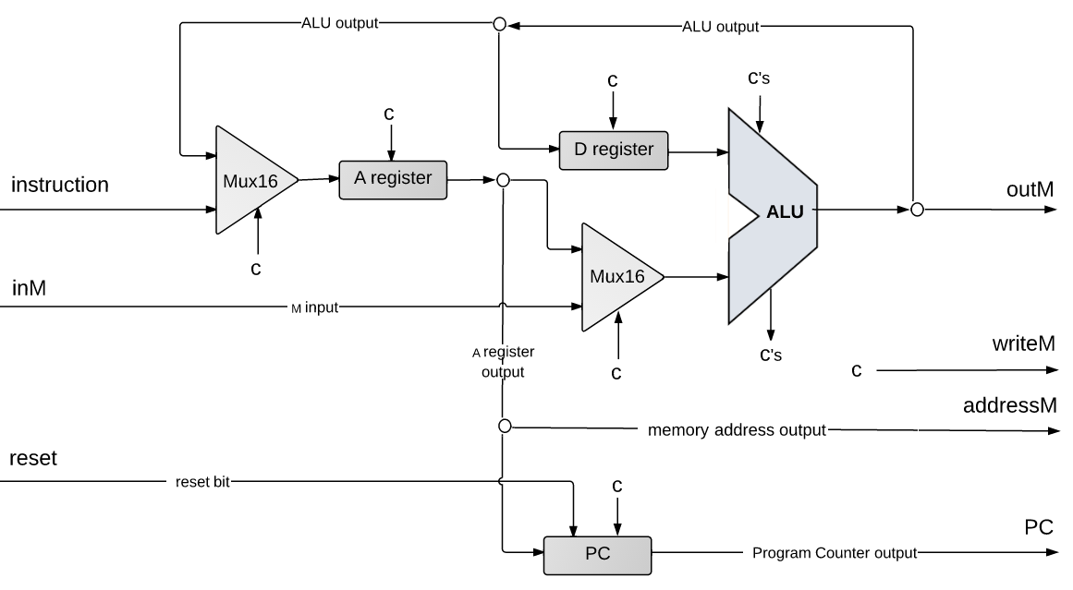
Hack procesor
pc

Slide 4
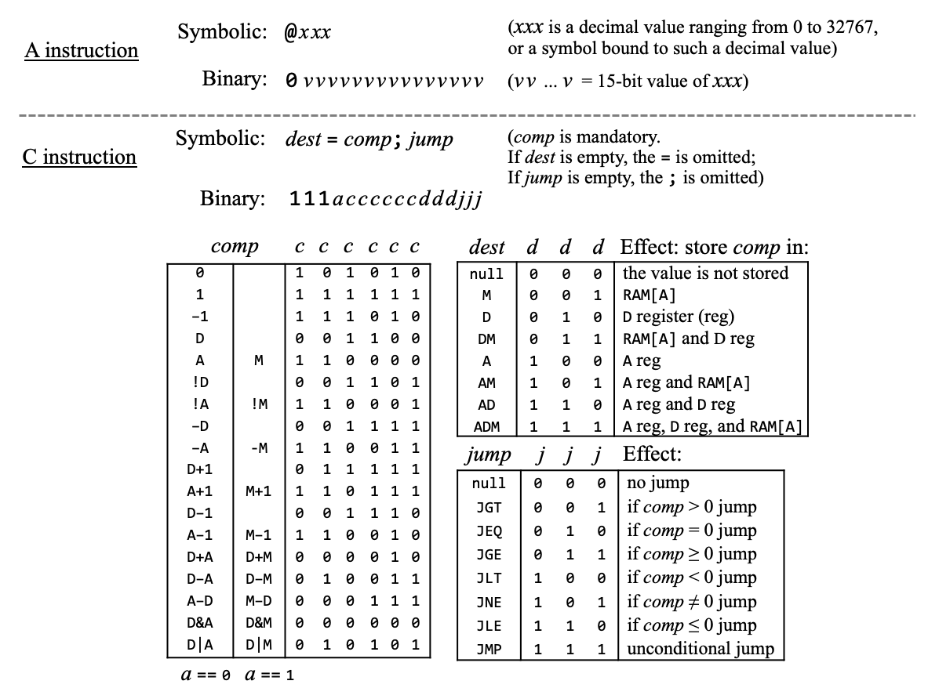

Slide 5
Zadatak
Implementirajte čip Memory
load
Memory
0
in
16
RAM16K
out
address
16383
16
16384
Screen
(8K)
15
24575
24576
Keyboard

Slide 6

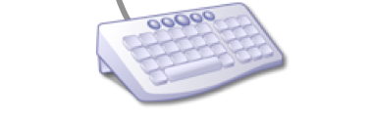
Zadatak
Implementirajte čip Memory
load
in
16
Memory
out
RAM16K
0
16
address
in
14
RAM16K
Hello, world
16
out
in
16383
16
16
out
address
address
Screen
16384
Screen
(8K)
16
15
13
24575
24576
Keyboard
out
Keyboard
16

Slide 7
Zadatak
Implementirajte čip Memory
000000000000000
RAM16K
011111111111111
100000000000000
Screen
(8K)
101111111111111
110000000000000
Keyboard

Slide 8
Zadatak
Implementirajte čip Memory
000000000000000
RAM16K
011111111111111
100000000000000
Screen
(8K)
101111111111111
110000000000000
Keyboard

Slide 9
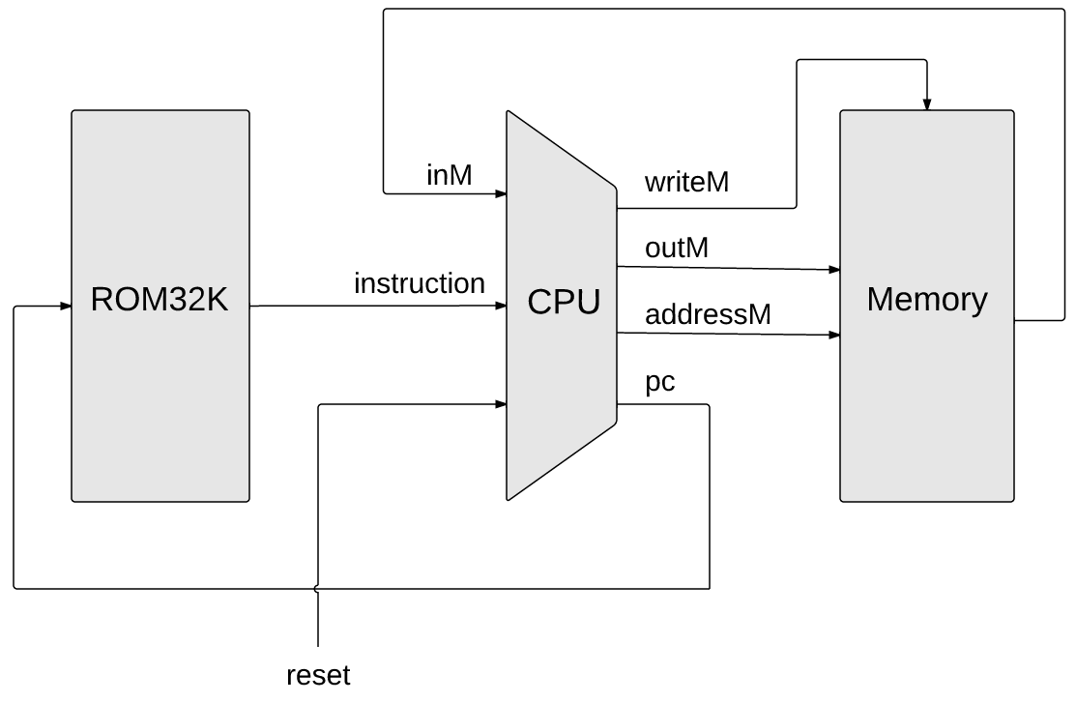

Zadatak
Implementirajte računalo (Computer)
Hello, world
reset

